Slide 1
Getting Started with Mockito

Slide 2

A few words on unit testing
Demo application overview Write a unit test without mocks Install Mockito 2
Overview
Edit the unit test to use a mock
Unit testing and mocking in more detail An overview of Test Doubles

Slide 3






Course Outline
Using partial mocks and advanced mocking techniques
Verifying that mocked methods behave accordingly
Getting started with Mockito
Configuring return values of mocked methods
Using Mockito’s behavior-driven development support

Slide 4


Unit Testing

Slide 5

Unit Testing
Unit

Slide 6

Unit Testing
Unit
Unit

Slide 7

Demo company overview
Demo application overview The first test:
Demo
without mocks
with mocks

Slide 8










Demo company overview
Clients
Company

Slide 9
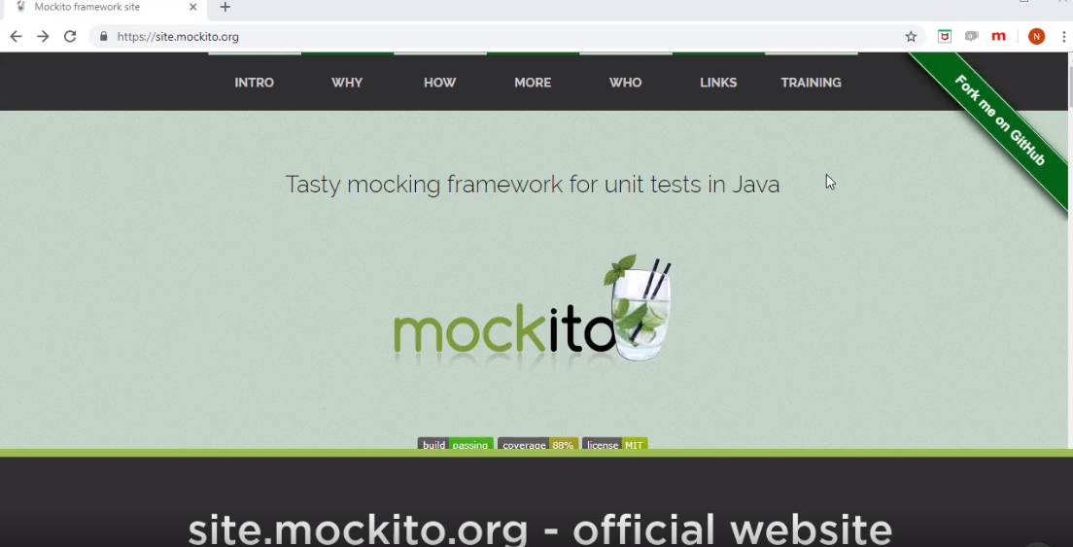

Slide 10


Mocking

Slide 11

Mocking
Unit
Collaborator (dependency)

Slide 12


Most Popular Collaborators for Mocking

Slide 13

Most Popular Collaborators for Mocking

Slide 14
Most Popular Collaborators for Mocking
Mock

Slide 15
Mocking
Unit
Real dependency

Slide 16
Mocking
Unit
Mock

Slide 17
Mocking
Mocking allows you to focus on the unit you’re trying to test by replacing the unit’s real dependencies with test-only collaborators. This allows you to reason about the unit in isolation, without having to deal with the rest of the codebase at the same time.

Slide 18




Why Use Mocking?
Eliminates non- determinism
And randomness
Reduces complexity
Increases flexibility
Improves test execution:
Supports collaboration
Speed
Reliability

Slide 19
“Double is a generic term for any case where you replace a production object for testing purposes.”
Martin Fowler

Slide 20





Test Doubles
Dummy
Fake
Stub
Spy
Mock

Slide 21



Test Doubles: Dummy
Not used in the test
Fills-in holes
Just keeps the compiler happy

Slide 22



Test Doubles: Fake
Implementation that is unsuitable for production
In-memory DB
Fake web service

Slide 23

Test Doubles: Stub
Provides ‘canned’ answers
Not intelligent enough to respond with anything else
Multiple variations are possible

Slide 24



Test Doubles: Spy
Like a more intelligent Stub
Keeps track of how it was used
Also helps with verification

Slide 25
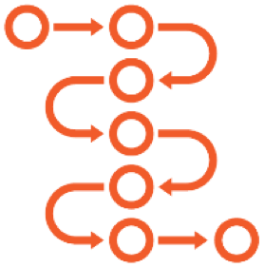


Test Doubles: Mock
Uses expectations
Can fail the test if unexpected calls are made
The focus is on behavior verification

Slide 26
State Verification Versus Behavior Verification
State Verification
All other Test Doubles do it Verify resulting state
Exception: Spies can verify behavior
Behavior Verification
Mocks always use it Verify interactions
Can add state verification on top

Slide 27

For ease of learning, we’ll focus on Spies and Mocks

Slide 28
A Few More Words on Unit Testing
Unit

Slide 29
A Few More Words on Unit Testing
Unit
Unit

Slide 30
“But really it's a situational thing - the team decides what makes sense to be a unit for the purposes of their understanding of the system and its testing. ”
Martin Fowler

Slide 31

A Unit Can Consist of More Than One Class
private AccountOpeningService underTest;
private BackgroundCheckService backgroundCheckService =
mock(BackgroundCheckService.class); private ReferenceIdsManager referenceIdsManager =
mock(ReferenceIdsManager.class); private AccountRepository accountRepository =
mock(AccountRepository.class);
@BeforeEach void setUp() {
underTest = new AccountOpeningService(
backgroundCheckService,
referenceIdsManager, accountRepository);
}

Slide 32

A Unit Can Consist of More Than One Class
private AccountOpeningService underTest;
private BackgroundCheckService backgroundCheckService =
mock(BackgroundCheckService.class); private ReferenceIdsManager referenceIdsManager =
new ExternalNationalReferenceIdsManager(…);
private AccountRepository accountRepository =
mock(AccountRepository.class);
@BeforeEach void setUp() {
underTest = new AccountOpeningService(
backgroundCheckService,
referenceIdsManager, accountRepository);
}

Slide 33
Unit Formation: Paradigm Comparison
Object-Oriented
A class A collection of classes
Functional
A function
A collection of functions

Slide 34
Unit Formation: Paradigm Comparison
Object-Oriented
A class A collection of classes
Functional

Slide 35
Do You Mock Concrete Classes or Interfaces?
Class
Interface

Slide 36
Do You Mock Concrete Classes or Interfaces?
Mockito
Can mock a class Can mock an interface
Other frameworks
Other frameworks may only allow mocking at interface level:
by design
due to technical reasons

Slide 37
Do You Mock Concrete Classes or Interfaces?
Generally speaking, prefer interfaces over concrete classes in order to follow SOLID principles.

Slide 38
Current version: 4.0.0
Open source
API design goals: clean, simple
Readable tests
Stats according to https://site.mockito.org/:
Top 10 Java libraries
SO voted Mockito best Java mocking lib
Mockito Facts

Slide 39
Described unit testing
Presented the application Wrote a test without mocks
Summary
Wrote tests with mocks using Mockito
Discussed mocking in detail Described each Test Double

